Slide 1
OS HACKATHON
Mini Shell
A Linux shell with background job management
Team: M. Lalitha (2520080063), S. Himasree (2520090181), P. Sravya (2520090059)
Guide: Dr. ALekhya
Built in C | POSIX system calls | WSL Ubuntu

Slide 2
PROBLEM STATEMENT
Why build a shell with job control?
The shell is the user's gateway to the OS. Doing it well means managing processes, not just launching them.
Blocked terminal
No visibility
No control
Long-running commands freeze the prompt. Users need to keep working while tasks run in the background.
Without job tracking you lose track of PIDs, states and run time of background processes.
Stopping, resuming or killing a task needs a simple interface, plus clean exit with no orphans.
2 / 7

Slide 3
WHAT WE SET OUT TO DO
Objectives
01 Execute commands
02 Background jobs
Parse input and run any program found in PATH, with arguments.
Run commands with a trailing & and return to the prompt immediately.
03 List jobs
04 Terminate and control
Show job ID, PID, state (Running / Stopped / Finished) and elapsed time.
kill, stop and resume jobs by number; clean up all children on exit.
3 / 7

Slide 4
HOW IT WORKS
System design
Read line
(fgets)
Parse
(strtok)
Built-in?
cd, jobs, kill
fork()
execvp()
in child
>
>
>
>
Parent then: foreground = waitpid() and block | background (&) = record job, return to prompt
fork()
execvp()
waitpid()
Duplicates the shell. The child becomes the command; the parent stays in the loop.
Replaces the child image with the program, searching PATH. Prints an error and exits 127 on failure.
Blocks for foreground jobs. WNOHANG | WUNTRACED polls background jobs without blocking.
4 / 7

Slide 5
TOOLS AND TECHNIQUES
Implementation
C language
Linux syscalls
WSL Ubuntu
Single file, about 400 lines. Fixed job table (100 jobs), 100-entry command history.
fork, execvp, waitpid, kill (SIGTERM / SIGSTOP / SIGCONT), chdir.
Compiled with gcc and run natively in the Ubuntu terminal on Windows.
$ gcc -Wall -Wextra -std=c11 mini_shell.c -o mini_shell
$ ./mini_shell
Built-ins: jobs, history, cd, kill, stop, resume, exit
5 / 7

Slide 6
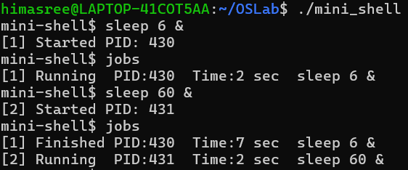
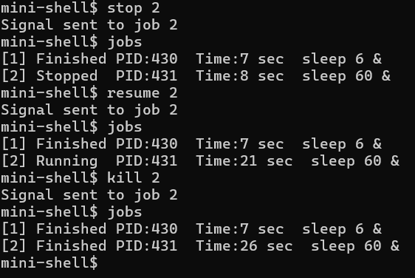
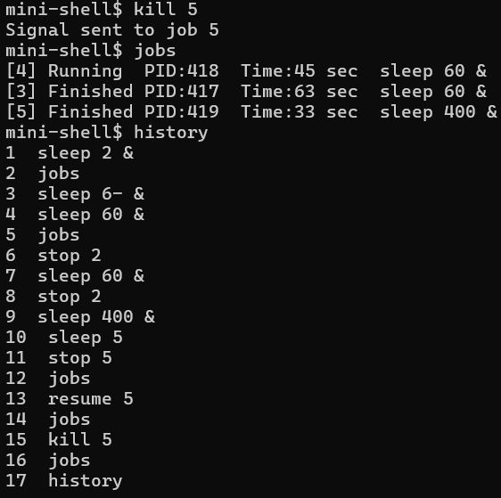
SAMPLE SESSIONS
Testing and results
Background jobs
Control and kill
Command history
Actual output captured from the mini shell running in Ubuntu (WSL).
6 / 7

Slide 7
WRAP UP
Conclusion and future scope
What works
Limitations
Future scope
Foreground and background execution
Job list with states and timing
stop / resume / kill
History, cd, error handling
Clean shutdown of all children
No pipes or redirection
No quoting or wildcards
No Ctrl+C / Ctrl+Z handling
Fixed job table and line size
No fg / bg commands
Pipes (|) and I/O redirection
SIGCHLD handler, process groups
fg / bg with terminal control
Quoting, variables, tab completion
Scripting support
7 / 7

